Slide 1


BIOSENSOR AND
IT’S APPLICATION
Definition (Satvik Shukla21SCSE1010146)
Introduction (Saurabh Kumar sah21SCSE1011305)
Types (Shivam Dwivedi 21scse1010662)
Principle(Saurabh Sharma21SCSE1010780)

Slide 2
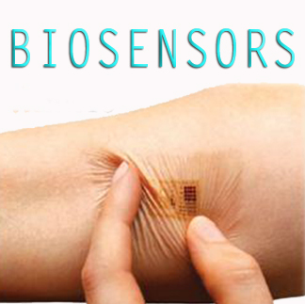

Slide 3
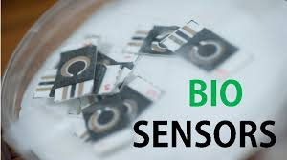
Definition
A biosensor is an analytical device, used for the detection of an analyte, that combines a biological component with a physicochemical detector.

Slide 4
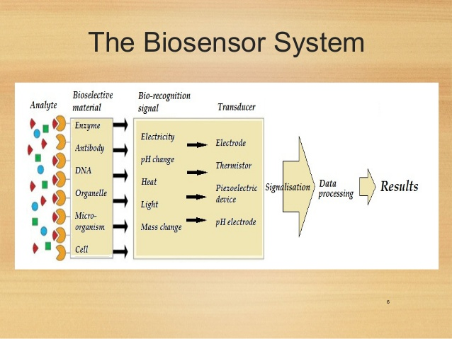
Biosensor system

Slide 5
Introduction
A biosensor is a sensing device comprised of a combination of a specific biological element and a transducer.
A specific biological element recognizes a specific analyte and the changes in the biomolecule are usually converted into and electrical signal ( which is in turn calibrated to a specific scale ) by a transducer.
It detects, records and transmits information regarding a physiological change or process.

Slide 6
A successful biosensor must possess at least some of the following beneficial features:
The biocatalyst must be highly specific for the purpose of the analyses, be stable under normal storage conditions and, except in the case of colorimetric enzyme strips
The reaction should be as independent of such physical parameters as stirring, pH and temperature as is manageable. This would allow the analysis of samples with minimal pre-treatment.
The response should be accurate, precise, reproducible and linear over the useful analytical range, without dilution or concentration. It should also be free from electrical noise.

Slide 7
If the biosensor is to be used for invasive monitoring in clinical situations, the probe must be tiny and biocompatible, having no toxic or antigenic effects. If it is to be used in fermenters it should be serializable. This is preferably performed by autoclaving but no biosensor enzymes can presently withstand such drastic wet-heat treatment. In either case, the biosensor should not be prone to fouling or proteolysis.
The complete biosensor should be cheap, small, portable and capable of being used by semi-skilled operators.

Slide 8
Glucometer
Current glucometers use test strips containing glucose oxidase, an enzyme that reacts to glucose in the blood droplet,
When the strip is inserted into the meter, the flux of the glucose reaction generates an electrical signal
The glucometer is calibrated so the number appearing in its digital readout corresponds to the strength of the electrical current

Slide 9
Bio-element
It is a typically complex chemical system usually extracted or derived directly from a biological organism.
Types
Enzymes
Oxidase
Polysaccharide
Antibiotics
Tissue
Nucleic acid

Slide 10
Conti…
Function
To interact specifically with a target compound i.e compound to be detected.
It must be capable of detecting the presence of a target compound in the test solution.
The ability of a bio-element to interact specifically with the target compound (specifically) is the basis for biosensor.

Slide 11
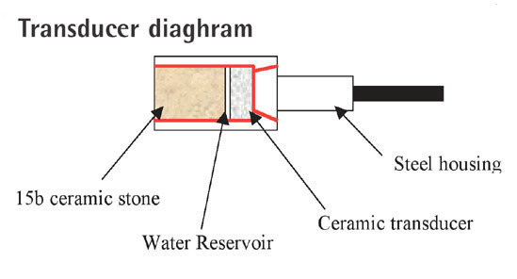
Tranducer
Function
To convert biological response in to an electrical signal.
Types
Electrochemical
Optical
Piezoelectric

Slide 12
Response From Bio-element
Heat absorbed (or liberated) during the interaction.
Movement of electrons produced in a redox reaction.
Light absorbed ( or liberated ) during the interaction.
Effect due to mass of reactants or products.

Slide 13
Types Of Biosensors
Electrochemical biosensor
Optical biosensor
Thermal biosensor
Resonant biosensor
Ion-sensitive biosensor

Slide 14
Electrochemical biosensor
Principle:
Many chemical reactions produce or consume ions or electrons which in turn cause some change in the electrical properties of the solution which can be sensed out and used as measuring parameter.
Classification:
Amperometric Biosensors
Conductimetric Biosensors
Potentiometric Biosensors

Slide 15
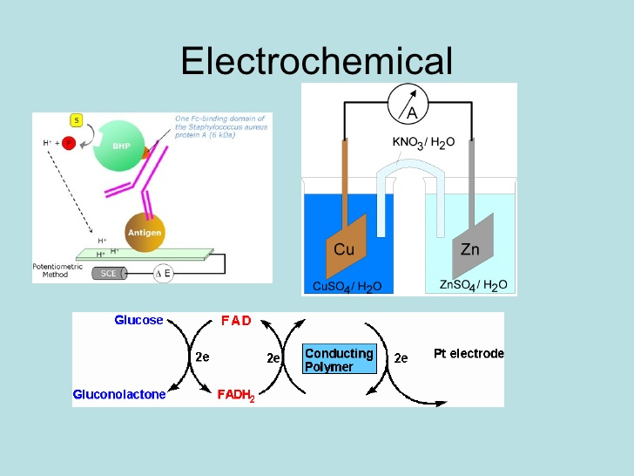
Electrochemical biosensor

Slide 16
Amperometric Biosensors
The high sensitivity biosensor can detect electro-active species present in biological test samples.
Since the biological test samples may not be intrinsically electro-active, enzymes are needed to catalyze the production of radio-active species.
In this case, the measured parameters is current.

Slide 21
Conductimetric Biosensors
The measured parameter is the electrical conductance resistance of the solution.
When electrochemical reactions produce ions or electrons, the overall conductivity or resistivity of the solution changes. This change is measured and calibrated to a proper scale (Conductance measurements have relatively low sensitivity).
The electric field is generated using a sinusoidal voltage (AC) which in minimizing undesirable effects such as Faradaic process, double layer charging and concentration polarization.

Slide 22
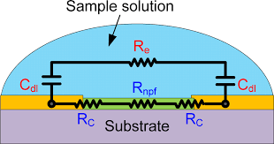
Conductimetric biosensor

Slide 23
Potentiometric biosensors
In this type of sensor the measured parameter is oxidation or reduction potential of an electrochemical reaction.
The working principle relies on the fact that where a ramp voltage is applied to an electrode in solution, a current flow occurs because of electrochemical reactions.
The voltage at which these reaction occurs indicate a particular reaction and particular species.

Slide 24
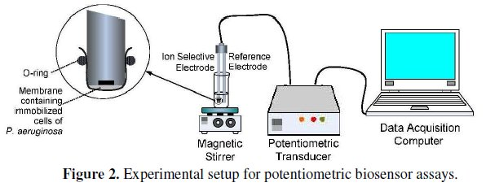
Potentiometric biosensor

Slide 25
Optical detection biosensor
The output transduced signal that is measured is light for this type of biosensor.
The biosensor can be made based on optical diffraction. In optical diffraction based devices, a silicon wafer is coated with a protein via covalent bonds. The wafer is exposed to UV light through a photo-mask and the antibodies becomeinactive in the exposed regions. When the diced wafer chips are incubated in an analyte, antigen-antibody bindings are formed in the active regions , thus creating a diffraction grating. This grating produces a diffraction signal when illuminated with a light source such as laser. The resulting signal can be measured.

Slide 26
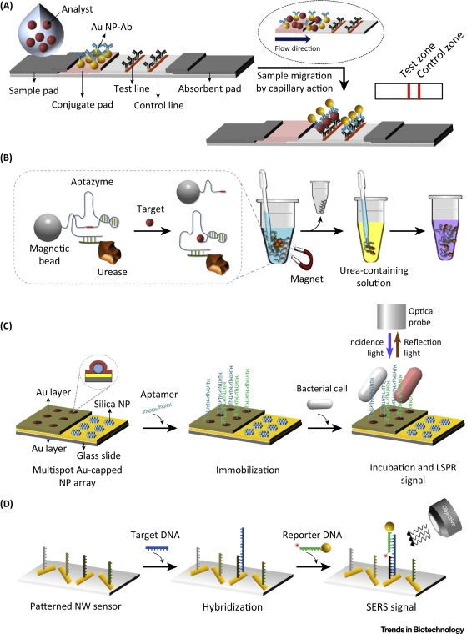
Optical detection biosensor

Slide 27
Thermal detection biosensors
This type of biosensor work on the fundamental properties of biological reactions, namely absorption or production of heat , which in turn changes the temperature of the medium in which the reaction takes place.
They are constructed by combining immobilized enzymes molecules with the temperature sensors. When the analyte comes in contact with the enzyme is measured and is calibrated against the analyte concentration.
The total heat produced or absorbed is proportional to the molar enthalpy and the total number of molecules in the reaction.

Slide 28
Conti…
The measurement of the temperature is typically accomplished via a thermistor, and such devices are known as enzyme thermistors. Their high sensitivity to thermal changes makes thermistor ideal for such applications.
Unlike other transducers, thermal biosensors do not need frequent recalibration and are insensitive to the optical and electrochemical properties of the sample.
Common applications of this type of biosensors includes the detection of pesticides and pathogenic bacteria.

Slide 29
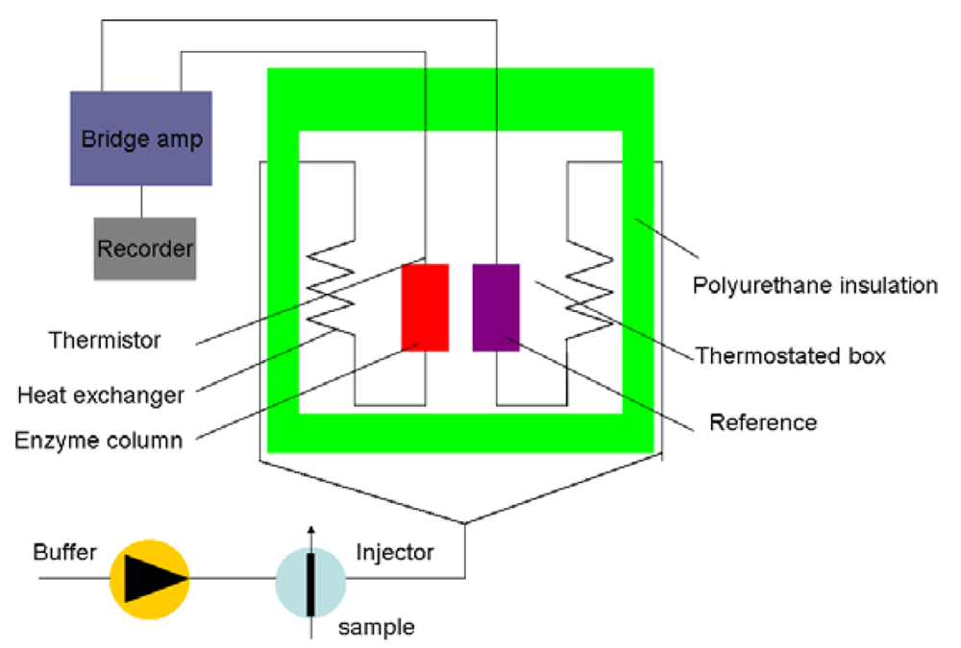
Thermal detection biosensors

Slide 30
Resonant biosensors
It utilize crystal which undergo an electric deformation when an electrical potential is applied to them. (Alternating potential (A.C) produces a standing wave in the crystal at a characteristic frequency)
In this type of biosensor, an acoustic wave transducer is coupled with an antibody (bio-element).

Slide 31
Conti…
When the analyte molecule (or antigen) gets attached to the membrane, the mass of the membrane, the mass of the membrane changes. The resulting change in the mass subsequently changes the resonant frequency of the resonant frequency of the transducer. This frequency change is then measured.

Slide 32
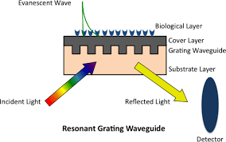
Resonant biosensors

Slide 33
Ion sensitive biosensor
These are semiconductor FETs having an ion-sensitive surface.
The surface electrical potential changes when the ions and semiconductor interact. (This change in the potential can be subsequently measured).
The Ion sensitive Fielf Effect Transistor (ISFET) can be constructed by covering the sensor electrode with a polymer layer. This polymer layer is selectively permeable to analyte ions. The ions diffuse through the polymer layer and in return cause a change in the FET surface potential.

Slide 34
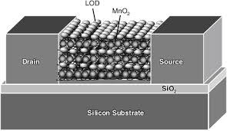
Conti…
This type of biosensor is also called an ENFET (Enzyme Field Effect Transistor) and is primarily used for pH detection.

Slide 35
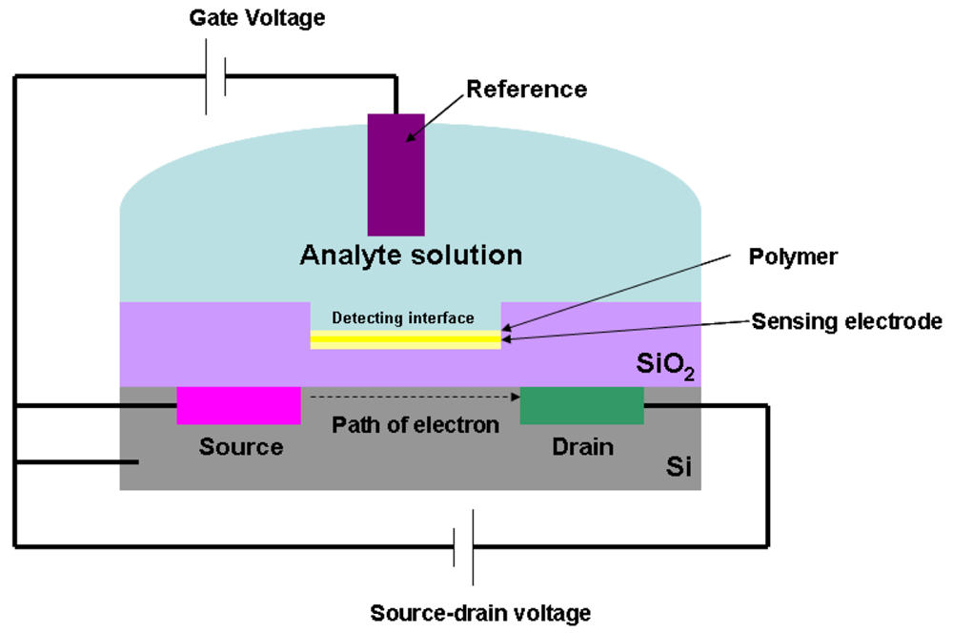
Ion sensitive biosensors

Slide 36
Glucose biosensors
Glucose reacts with glucose oxidase to form gluconic acid. Two electrons and two protons are also produced.
Glucose mediator reacts with surrounding oxygen to form H2O2 and glucose oxidase.
Now this glucose oxidase react with more glucose.
Higher the glucose content, the higher the oxygen consumption.
Glucose content can be detected by Pt-electrode.

Slide 37
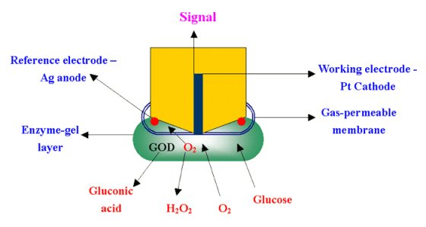
Glucose biosensors

Slide 38
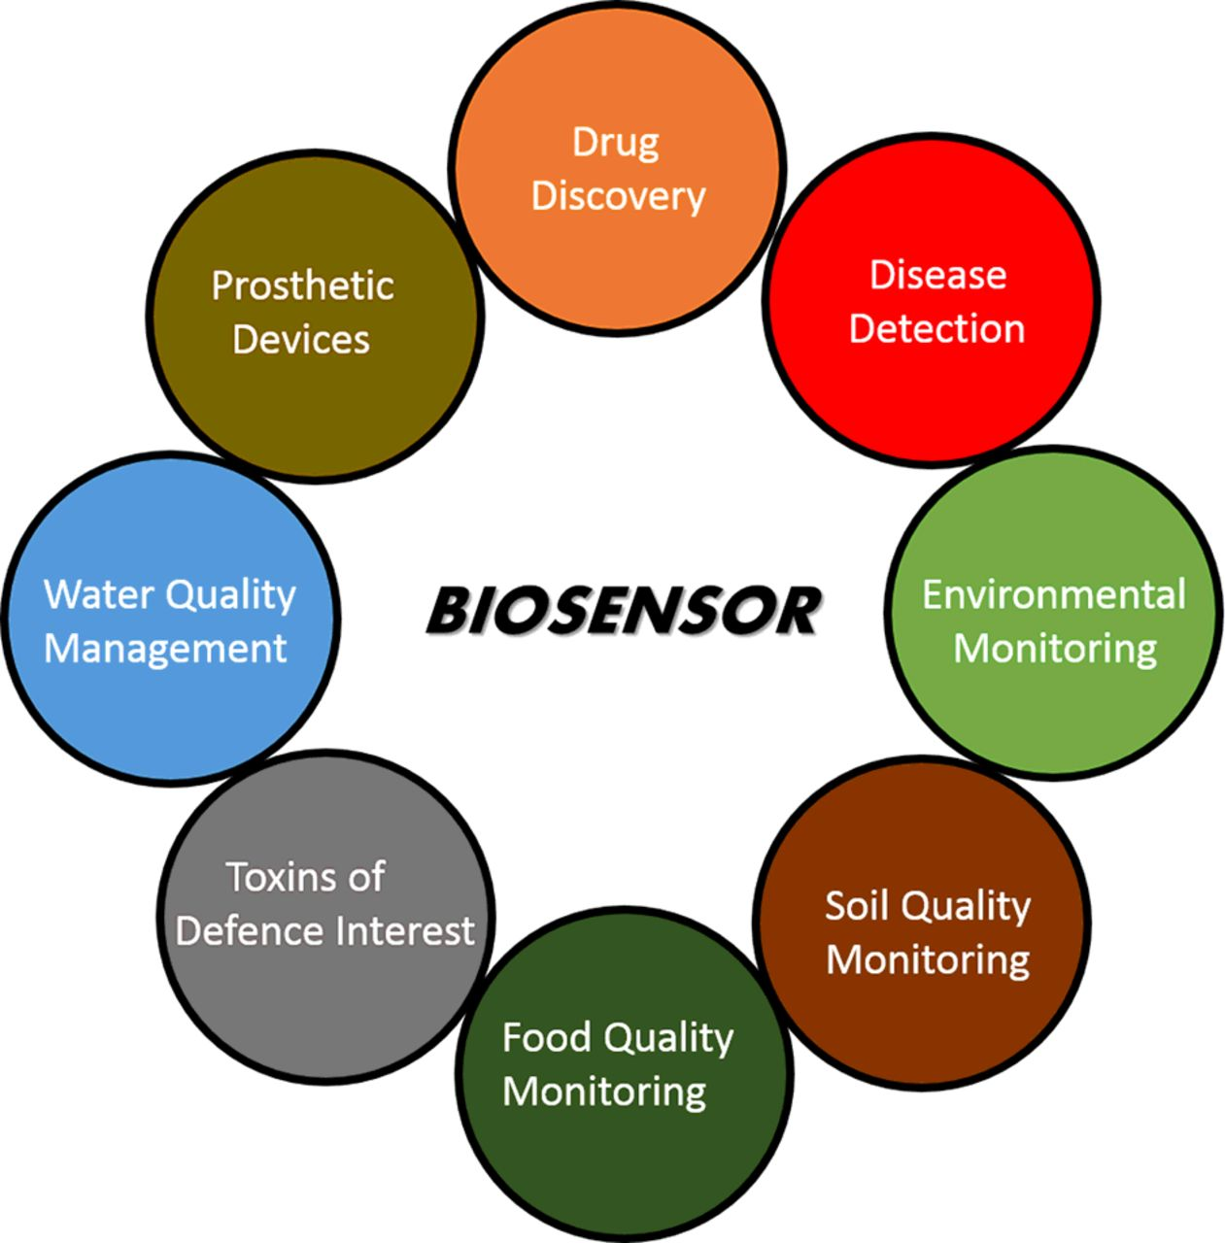
Applications

Slide 39
Conclusion
As the potential threat to bioterrorism increase, there is great need for a tool that can quickly, reliably and accurately detect contaminating bio-agents in the atmosphere.
Biosensors can essentially serve as low-cost and highly efficient devices for this purpose in addition to being used in other day-to-day application.
Biosensors are known as immuno-sensors,optrodes, chemical, canaries, resonant mirrors, glucometers biochips bio-computers and so on.

